Slide 1
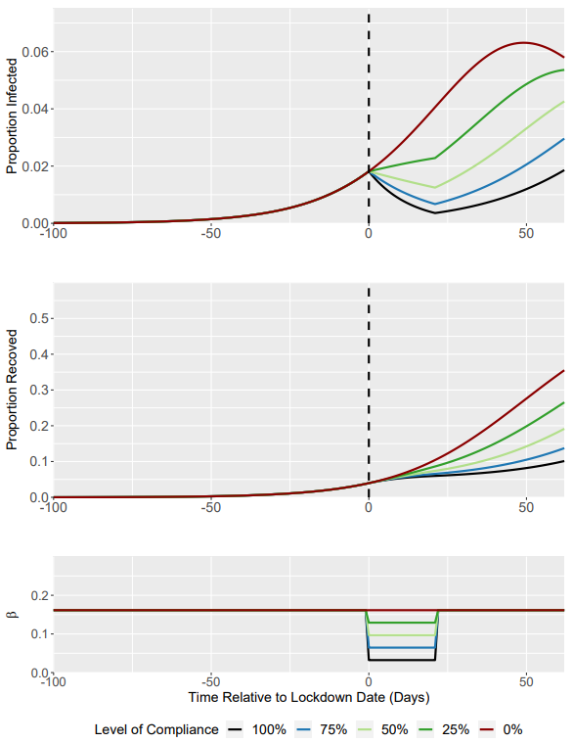
Compliance Level | R₀ under Lockdown (Baseline = 1.5) | I(t) at Lockdown Trigger | I(t) at 3 weeks post-Lockdown | Time to Return to Pre-lockdown I(t)
100 | 0.3 | 0.0182 | 0.004 | 41
75 | 0.6 | 0.0182 | 0.007 | 26
50 | 0.9 | 0.0182 | 0.013 | 10
25 | 1.2 | 0.0182 | 0.023 | N/A
0 | 1.5 | 0.0182 | 0.041 | N/A
For a lockdown compliance of 100% (R₀ = 0.3), I(t) returns to pre-lockdown levels (0.0182) ~41 days after cessation of the 3 week lockdown.

